Slide 1
Contract Management
DR M ASGHAR MUGHAL
Lecture 5

Slide 2
Contract: Definition
A contract is a mutually and legally binding agreement that obligates the seller to provide specified products or services, and obligates the buyer to pay for them.

Slide 3
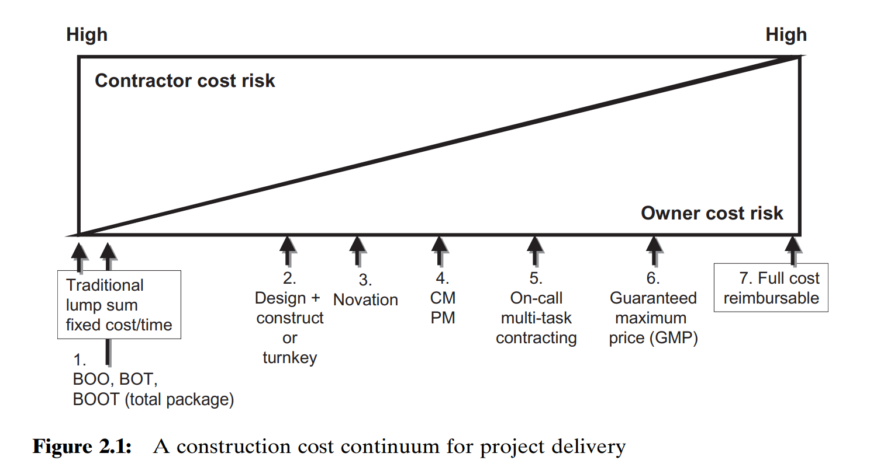
Procurement Contract Choices

Slide 4
Definitions
BOOT- Built, Own, Operate, Transfer
BOT- Built, Operate Transfer
BOO - Built, Operate, Own
Design and Construct / Turn Key
Novation – Shifting of Contract
CM/PM – Construction Management/ Project Management

Slide 5
Contract: Definition
Different types of contracts are suited to particular circumstances, there are three broad categories:
Fixed price or lump sum: involve a fixed total price for a well-defined product or service.
Cost reimbursable: involve payment to the seller for direct and indirect costs.
Time and Materials Contract: This is a hybrid contract of Fixed-Price and Cost Reimbursable contracts. Here, the risk is distributed to both parties.

Slide 6
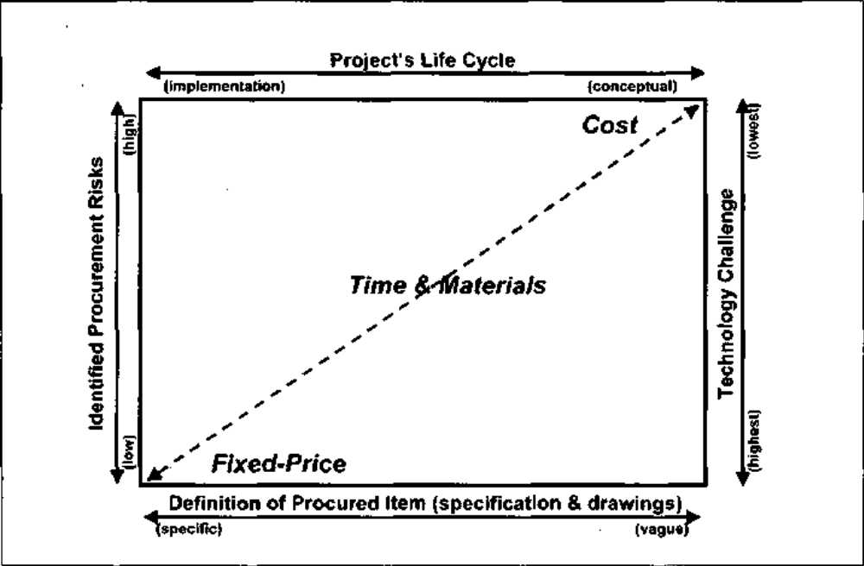
Scope and Risk: Fixed-Price Contracts

Slide 7
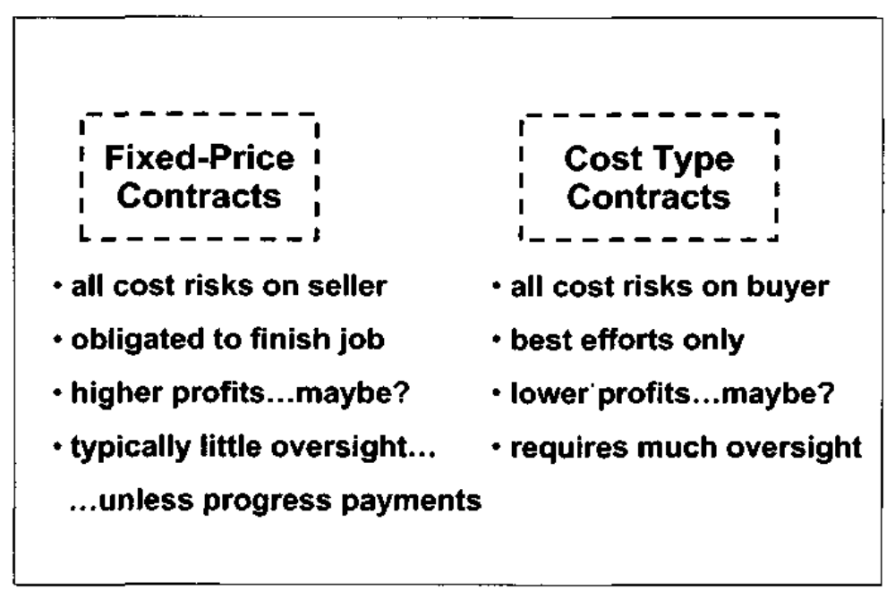
Comparison Between Fixed-Price and Cost Type Contracts

Slide 8
Basic Types of Contracts
Firm Fixed Price Contract
Cost Reimbursement Contract
Time and Material Contract

Slide 9
Fixed Price Contracts
Fixed price or lump sum contracts involve a fixed total price for a well-defined product or service. These contracts are particularly suited where supplies or services can be clearly specified before tenders are invited. The buyer incurs little risk in this situation.
It is the safest contract form to use if, and this is a big if:
  The project's buyer must know exactly what it wants to procure
  The buyer must be able to specify the desired article in very precise terms, so as to agree on a price between the buyer and seller
  The buyer must have reasonable confidence (probable assurances) that the item being procured will not subsequently change in specifications, or performance requirements, or terms, so as to require a redirection to the supplier.

Slide 10
Fixed Price Contract
ADVANTAGE:
  All that is required for payment is delivery of the stated item(s) for which the contract was issued.
  The main advantage of a Fixed-Price contract is that both parties know the scope of the work, and the total cost of the task before the work is started
DISADVANTAGE:
  Fixed price contract is most advantageous to the government and at the same time, inherently carries the maximum amount of risk to the contractor.
  This is because under the fixed price model, the government contracts with the institution for a given set of deliverables at a set price. Therefore, if expenditures exceed the fixed price contract amount, the Institution must bear the cost overruns.

Slide 11
Fixed Price Contract
DISADVANTAGE:
In practice the work is never completed without any changes in scope or “extra” work
The claim for “Extras or Variations” include
  Cost of design changes
  Charges based on errors and omissions in the contract documents used for tendering
  Cost from delays in claims
Often the LUMP-SUM contract end up providing opportunities for profit making to contractors.
It is also criticized for inviting confrontations approach to conflicts arising out of contract variations.

Slide 12
Cost Reimbursement Contracts
Cost-reimbursement types of contracts provide for payment of allowable incurred costs, to the extent prescribed in the contract.
Under the cost reimbursable type contract the sellers obligation is merely to provide a "best efforts" commitment to complete all of the work as stipulated in the contract.
It is the safest contract form to use if, and this is a big if, the project's buyer is sure that the scope of the procurements can not be locked at any cost.
Sellers are normally obligated to notify the buyer in advance if they anticipate exceeding the authorized funding levels.

Slide 13
Time And Materials Contract
Unit price contracts require the buyer to pay the seller a predetermined amount per unit of service, and the total value of the contract is a function of the quantities needed to complete the work.
Unit price contracts are also called a time and materials contract, and may incorporate volume discounts.
This type of contract is often used for services that are needed when the work cannot be clearly specified and total costs cannot be estimated in a contract. Many contract programmers and consultants prefer to use unit price contracts

Slide 14
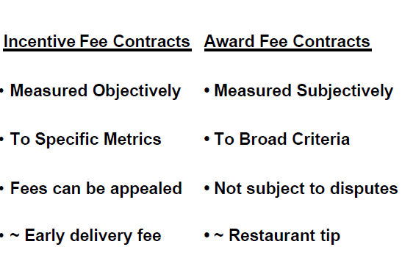
Available Variables in the Contract Types
Incentive Fee Contracts
Award Fee Contracts

Slide 15
Fixed Price Contracts

Slide 16
Fixed Price Contracts
Firm fixed-price contracts are used when it is determined that the price quoted by the contractor is reasonable to the client and when the client wants to procure the goods or services at that price without any opportunity for the contractor to obtain any adjustments in price based on actual expenditures incurred during the project.
Following are categories of Fixed price contracts:
  Firm Fixed-Price contract (FFP)
  Fixed Price Incentive Fee contract (FPIF)
  Fixed Price Award Fee (FPAF)
  Fixed Price with Economic Price Adjustment contracts (FP-EPA)

Slide 17
1. Firm Fixed-Price Contract (FFP)
In this type of contract, the fee is fixed.
The seller has to complete the job within an agreed amount of money and time.
Any cost increase due to bad performance of the seller will be the responsibility of the seller, who is contractually bound to complete the job within the agreed amount.
A Firm Fixed-Price contract is mostly used in government or semi-government contracts where the scope of work is specified with every possible detail outlined.
This type of contract is easy to float on the market, receive bids, and evaluate the bids primarily on a cost basis.
Since the risk is borne by the seller, the cost tends to be higher. Another drawback of a Firm Fixed-Price contract is possible disputes between the buyer and the seller if the scope is not clear. Moreover, any deviation from the original scope can cost you a lot.
Example: The seller has to complete the job for 100,000 USD within 18 months.

Slide 18
2. Fixed-Price Incentive Fee Contract (FPIF)
In this type of contract, although the price is fixed, the seller is given an additional incentive based on his performance. This incentive lowers the risk borne by the seller.
The incentive can be tied to any project metrics such as cost, time, or technical performance.
Example: 10,000 USD will be paid to contractor as an incentive if he completes the work before two months

Slide 19
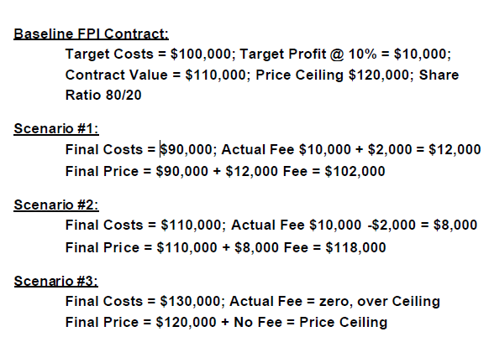
Example of FPIF Contract

Slide 20
3. Fixed-Price Contracts With Award Fees:
Award-fee provisions may be used in fixed-price contracts when the Government wishes to motivate a contractor and other incentives cannot be used because contractor performance cannot be measured objectively. Such contracts shall :
  (1) Establish a fixed price (including normal profit) for the effort. This price will be paid for satisfactory contract performance. Award fee earned (if any) will be paid in addition to that fixed price.
  (2) Provide for periodic evaluation of the contractor's performance against an award-fee plan.
Likely not to be found independently, rather, the award fee provisions would be additive to another fixed price type contract: FFP/AF, or FPI/AF, or FPEPA/AF.

Slide 21
4. Fixed-Price with Economic Price Adjustment Contracts (FP-EPA)
If the contract is multi-year long, a Fixed-Price with Economic Price Adjustment contract is used. Here, you include a special provision in a clause which protects the seller from inflation.
Economic price adjustments are of three general types:
  (a) Adjustments based on established prices
  (b) Adjustments based on actual costs of labor or material
  (c) Adjustments based on cost indexes of labor or material
Example: About 3% of the cost of the project will be increased after a certain time duration based on the Consumer Price Index.
Purchase Order (PO)
This type of contract is used to buy commodities.
Example: Buy 10,000 bolts at the cost of 1.00 USD

Slide 22
Cost Reimbursable Contracts

Slide 23
Cost Reimbursable Contracts
Cost reimbursable or cost-plus contracts involve payment to the seller for direct and indirect actual costs. These contracts are often used for projects that include the provision of goods and services associated with new technologies. The buyer absorbs more risk with the type of contract, which has three forms:
  Cost plus incentive fee (CPIF): the buyer pays the seller for allowable performance costs plus a predetermined fee and an incentive bonus.
  Cost plus fixed fee (CPFF): the buyer pays the seller for allowable performance costs plus a fixed fee payment usually based on a percentage of estimated costs.
  Cost plus percentage of costs (CPPC): the buyer pays the seller for allowable performance costs plus a predetermined percentage based on total costs.

Slide 24
Cost Plus Fixed Fee (CPFF):
A cost-plus-fixed-fee contract is a cost-reimbursement contract that provides for payment to the contractor of a negotiated fee that is fixed at inception of the contract.
The fixed fee does not vary with actual cost, but may be adjusted as a result of changes in the work to be performed under the contract.
Appropriate anytime there are:
  Substantial cost uncertainties
  Where estimates of costs are difficult or impossible to accurately forecast.
  High technical uncertainty, challenging schedule goals
Sub-Types:
The Completion Form: Payable on Completion of Goals
The Term Form: Payable at Specified Period of Time

Slide 25
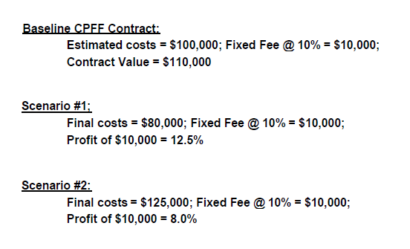
Example of CPFF Contract

Slide 26
Cost Plus Incentive Fee (CPIF):
The cost-plus-incentive-fee contract is a cost-reimbursement contract that provides for the initially negotiated fee to be adjusted later by a formula based on the relationship of total
This contract type specifies a target cost, a target fee, minimum and maximum fees, and a fee adjustment formula allowable costs to total target costs.
Distinction from CPFF: CPIF contracts contain no price ceiling beyond which the seller cannot recover costs
WHY CPIF contracts: Appropriate whenever there exists considerable technical risks, and the buyer would like to encourage the seller to minimize costs.
Types of Incentives:
  Deliveries of end-items ahead of schedule
  Product reliability
  Maintenance costs
  Weight of hard work and so forth

Slide 27
Element of CPIF:
CPIF contracts contain the following five elements:
  (1) a target cost
  (2) a target fee
  (3) a maximum allowable fee
  (4) a minimum allowable fee
  (5) A fee adjustment formula based on seller performance between the maximum or minimum fee ranges.

Slide 28
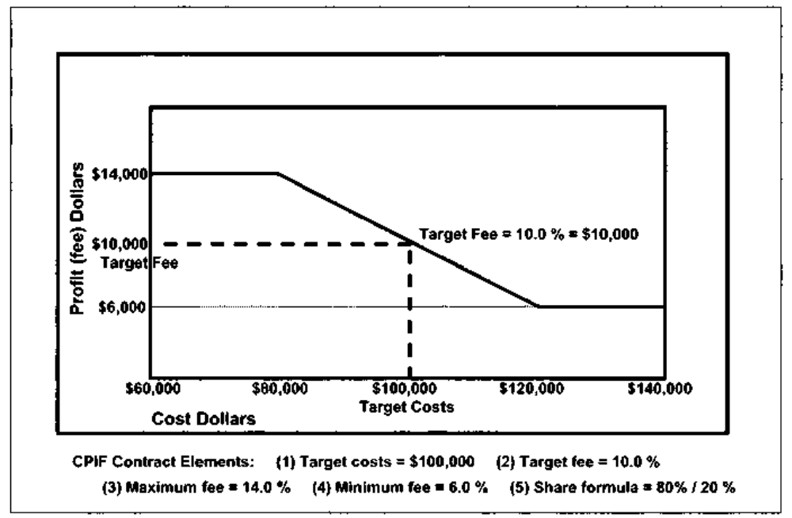
Example of CPIF Contract

Slide 29
Cost Plus Award Fee (CPAF):
A cost-plus-award-fee contract is a cost-reimbursement contract that provides for a fee consisting of
  (1) a base amount fixed at inception of the contract and
  (2) an award amount that the contractor may earn in whole or in part during performance and that is sufficient to provide motivation for excellence in such areas as quality, timeliness, technical ingenuity, and cost effective management.
Typically contain six elements:
  (1) Total estimated costs
  (2) A "base fee," stated as a percentage of total estimated costs
  (3) An "award fee," also stated as a percentage of total estimated costs
  (4) The award fee's broadly defined "performance criteria"
  (5) An award fee "evaluation board”; which evaluates the performance of the firm against the award criteria.

Slide 30
Unlike incentive fee provisions, award fee criteria are not to be subject to a mathematical formula, nor are they quantifiable.
Rather, the award fees are given out based on the "subjective“ determination of the evaluation board, typically requiring concurrence by the superior fee
determining executive who has the final say. The subjective terms refer to broadly stated criteria, and may fall into such general categories as:
  Technical achievements
  Management performance
  Allocation of adequate resources
  Product reproducibility
While the award fee type contract is normally used on cost reimbursable type contracts, it can also work well on any type of contract, even fixed price contracts, time and material contracts, etc. For example a "CPFF/AF" or "CPIF/AF" or FPIF/AF" orv"FFP/AF" type contract

Slide 31
Cost Plus a Percentage of Costs Fee |CPPCF):
Under the CPPCF contract, the seller's earned fee, or profit, increases as a stipulated percentage rate of funds actually expended.
There is no incentive on a seller to keep costs down to a minimum, in fact, the incentive is to spend more money and thus get a greater fee.
The CPPCF contract is a bad business arrangement for any project.

Slide 32
Cost Contracts:
  A cost contract is a cost-reimbursement contract in which the contractor receives no fee. A cost contract may be appropriate for research and development work, particularly with nonprofit educational institutions or other nonprofit organizations, and for facilities contracts.
Cost Sharing Contracts:
  A cost-sharing contract is a cost-reimbursement contract in which the contractor receives no fee and is reimbursed only for an agreed upon portion of its allowable costs. A cost-sharing contract may be used when the contractor agrees to absorb a portion of the costs, in the expectation of substantial compensating benefits.

Slide 33
Time and Materials Contracts
Time and Material (T&M) contracts are a hybrid type of contractual arrangement that contains aspects of both cost-reimbursable and fixed-price-type arrangements.
T&M contracts resemble cost-type arrangements in that they are open ended, because the full value of the arrangement is not defined at the time of the award.
Considered appropriate in those circumstances when it is not possible at the time of award to estimate accurately the extent, or duration, or costs of a job with any degree of confidence
The T&M contracts are used primarily to procure emergency services, repairs, maintenance, overhauls, but are also used extensively to procure engineering and technical services as purchased labor, where the direct supervision of the purchased people is done by project staff.
Labor costs typically carry all indirect expenses including profit, but material costs may carry material handing costs only, and are sometimes billed without profits.
Because of the risks of cost growth, the T&M type contracts are normally discouraged without justification.

Slide 34
Other Contract Types:
Labor-Hour Contracts:
  The "Labor-Hour" contract is a variation of the Time & Material (T&M) contract, but as the name implies, is restricted to labor services only, without materials supplied in the contractual arrangement.
Letter Contracts:
  A letter contract is a written preliminary contractual instrument that authorizes the contractor to begin immediately manufacturing supplies or performing services.
  Letter contracts, however, lack one key thing most contracts have: a "statement of work.“
  There is probably no contractual arrangement which has the potential of higher risks than with use of a letter contract. Why then would we ever consider using a letter contract?
  Letter contracts are used in circumstances when a seller must be authorized to start work immediately in order to support the project's effort, and a negotiated definitive contract is not possible in the time available

Slide 35
Some general guidelines for selection of contract type
1. Determinations of contract type are best done by a multifunctional procurement committee representing a broad cross-section of interests, for example procurement, engineering, manufacturing, contracts, finance, legal, quality, etc.
2. The best interests of both parties — the project and the seller — should be balanced, and both parties should mutually benefit from the final choice as to the contract type.
3. Any contract type other than a FFP must be justified on its own merits, and have a rationale to support the selection of a type other than a FFP.
4. However, it should be understood that even a FFP type contract can be the wrong type, whenever there are unknowns in the procurement statement of work and specification, and the potential sellers in any competition are likely to incorporate pricing "contingencies" into their contract proposals, in order to cover the unknown risks.

